Slide 1


Predicting Cryptocurrencies prices using Dark Web Transactions
Wong Wei Kang A0192204N
Jeremy Sim A0182400W
Justin Chu A0183794M
Notes:
Hi everybody. Welcome to our group’s presentation of the impact of dark web transactions on cryptocurrencies.

Slide 2

Introduction
Conclusion
01
Background
Data Collection and Preprocessing
Exploratory Data Analysis
03
Key Insights
Limitations
Time Series Analysis
02
VAR
Structural Analyses
VECM
Forecasting
Exploring Further Relationships
Notes:
Here is the run down of our presentation. We will begin with an introduction to our problem setting, followed by our analysis and key insights that we have discovered.

Slide 3
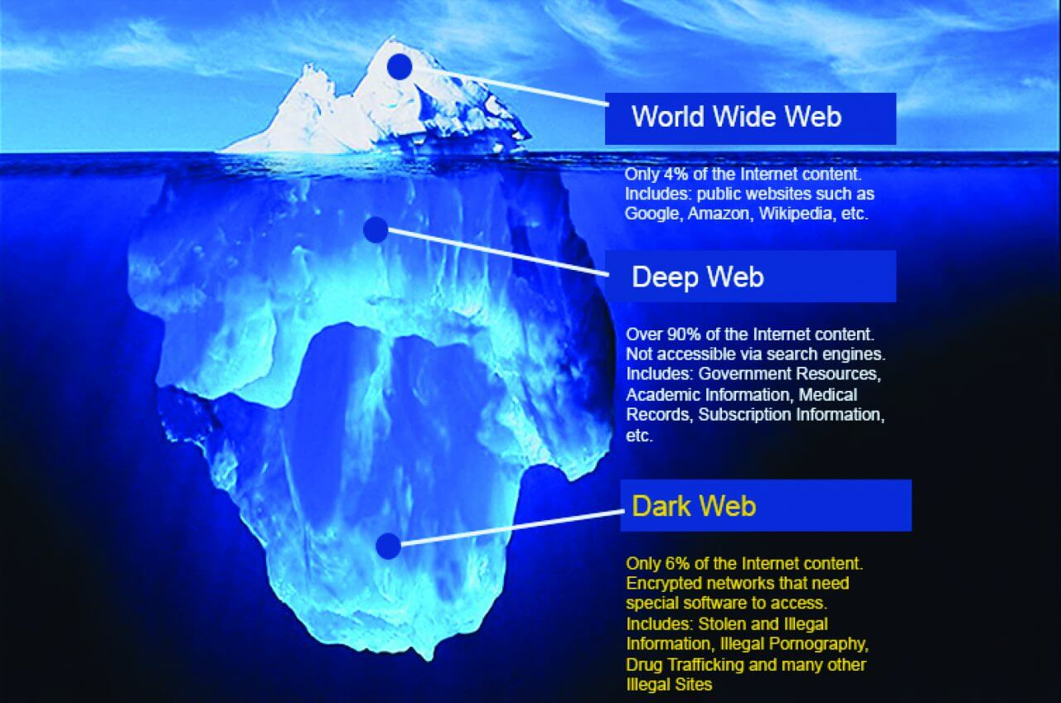
Notes:
Let us start with the Dark Web. What is it? Often confused with the “Deep Web”, the Dark Web refers to an encrypted online content not indexed by traditional search engines. Coined “the haven for illegal activities”, the dark web offers a high degree of anonymity for everyone involved. As you can see from the diagram, the Dark Web only comprises 6% of the Internet content. Cryptocurrencies are often used for transactions on the Dark Web because they allow users to obfuscate their identities and transaction details.

Slide 4


Introduction
2013 -> 2016
Transactions of illicit drugs on the Dark Web have tripled
Total drug revenues are in multi-million figures
Dominated by Cannabis, Stimulants & Ecstasy
Notes:
Let us rewind to the year 2016 which is the year we will conduct our data analysis. In fact, let us go back a further 3 years to 2013. In 2013, the FBI shut down the Silk Road, the first major cryptomarket on the dark web, which had launched the online trade of illegal goods, such as illicit drugs. From 2013 to 2016, the number of transactions of illicit drugs on the cryptomarkets has tripled, with revenues doubling. This is despite various law enforcement interventions and exit scams by online marketplaces Total drug revenues on cryptomarkets (excluding prescription drugs, alcohol and tobacco) during January 2016 were estimated to be between $12.0 (€10.5) million* and $21.1 (€18.5) million.

Slide 5
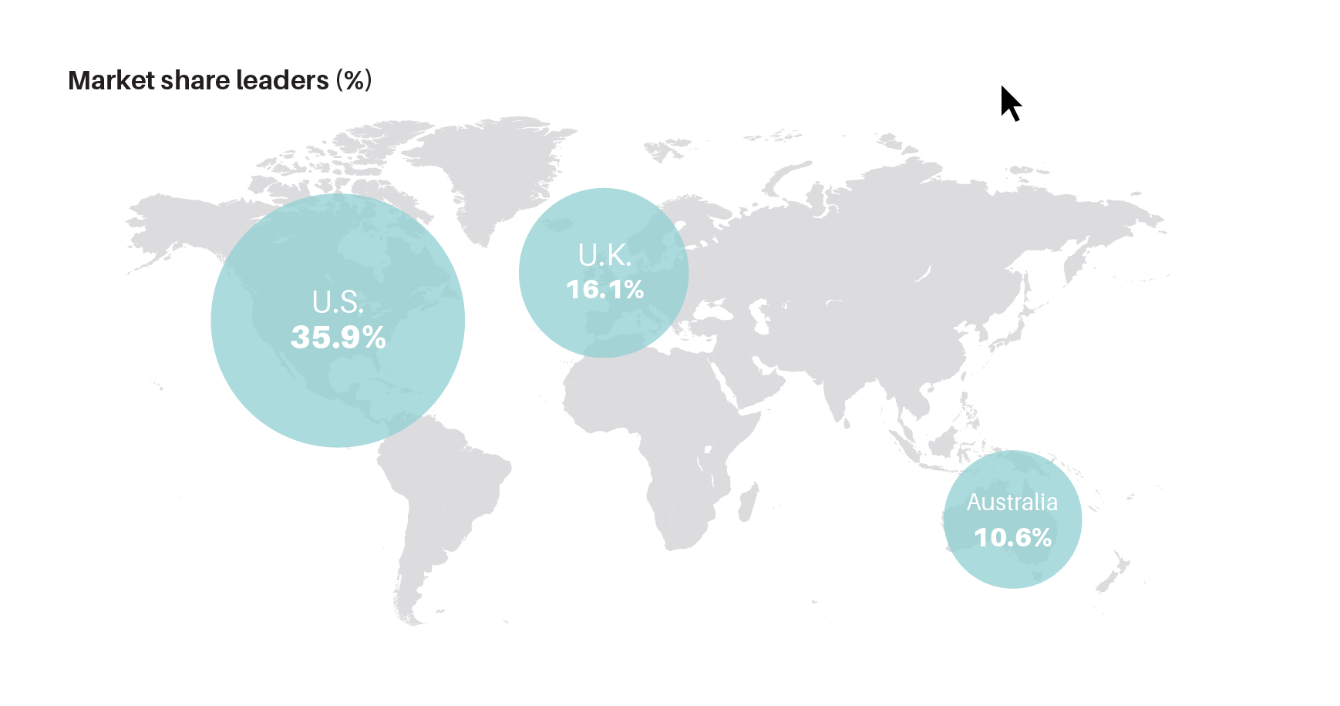
(Rand, 2016)
Notes:
Looking at this geographically, we can see that cryptomarkets are dominated by vendors from the U.S., Australia and Canada. The United States owns the market share of drugs at 35.9%, closely followed by the U.K. at 16.1% and Australia at 10.6%. Not shown here are the Netherlands at 7.1% and Germany at 8.4%.

Slide 6



Background
2016:
Notes:
2016 was also a very active year for cryptocurrencies. According to the AKAMAI THREAT ADVISORY, New cryptocurrencies found use alongside Bitcoin, namely Monero and ZCash. The general offerings of Monero, especially, saw a huge surge in popularity. Known to be a lot more secure than Bitcoin, especially when it came to obfuscation, it became highly popular. Moreover, since Monero does not use a public transaction ledger, it supports completely anonymous transactions. Zcash, another privacy-oriented cryptocurrency, had its speculation-hounded debut in 2016. It is one of the rare cryptocurrencies that utilised a non-interactive zero knowledge proof in which no interaction is necessary between prover and verifier.

Slide 7
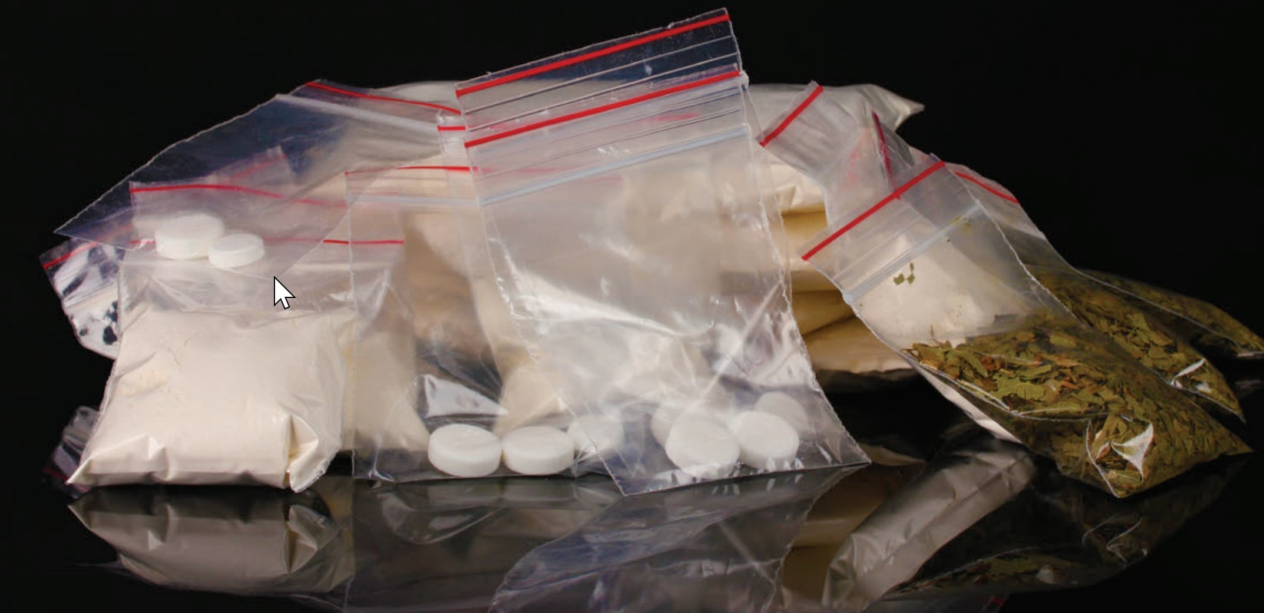

Background
Notes:
With the current rise in popularity of cryptocurrencies and blockchain, together with the immense drug sales on the Dark Web, we hope to explore relationships between these 2 entities. Specifically, the aim of our project is to explore if drug sales on the Dark Web can affect the prices of cryptocurrencies, and possibly, formulate models to predict these prices.

Slide 8

Data Collection
Notes:
Let us move on to data collection. In addition to our given dataset of Bitcoin and Dark Web Transactions, we obtained the historical prices of Monero and Z-Cash from the global financial portal - investing.com. After analysing the time period of the data, we have found a few problems. Firstly, data for Dark Web Transactions is limited to only 2016. Next, data for Z-Cash is only available for late October 2016. Hence, without sufficient data, we have decided to remove Z-Cash from our analysis. For the other 3 variables, we will analyse the data with the common time period - 2016.

Slide 9
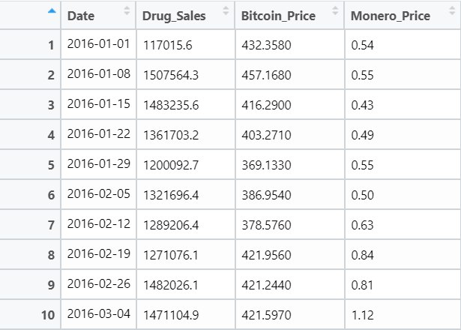
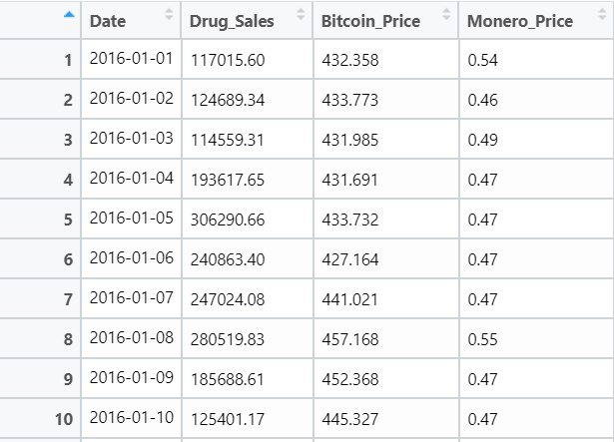
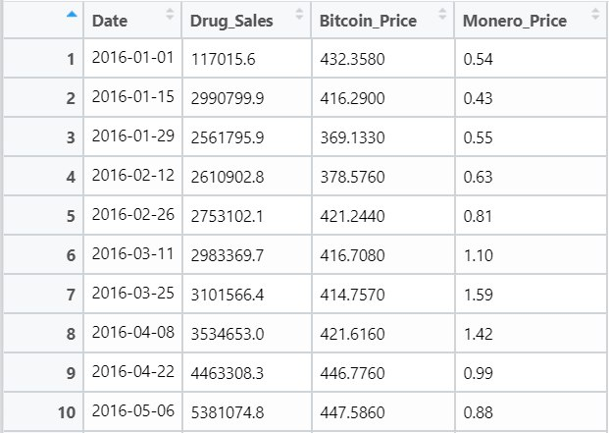
Data Pre-processing
Daily
Weekly
Biweekly
Notes:
We then merged our data, taking the Closing Prices of Bitcoin and Monero, and the total sales of Dark Web transactions. After merging the data, we next aggregate it for daily, weekly and biweekly time periods, allowing us to conduct analyses for these 3 time periods.

Slide 10
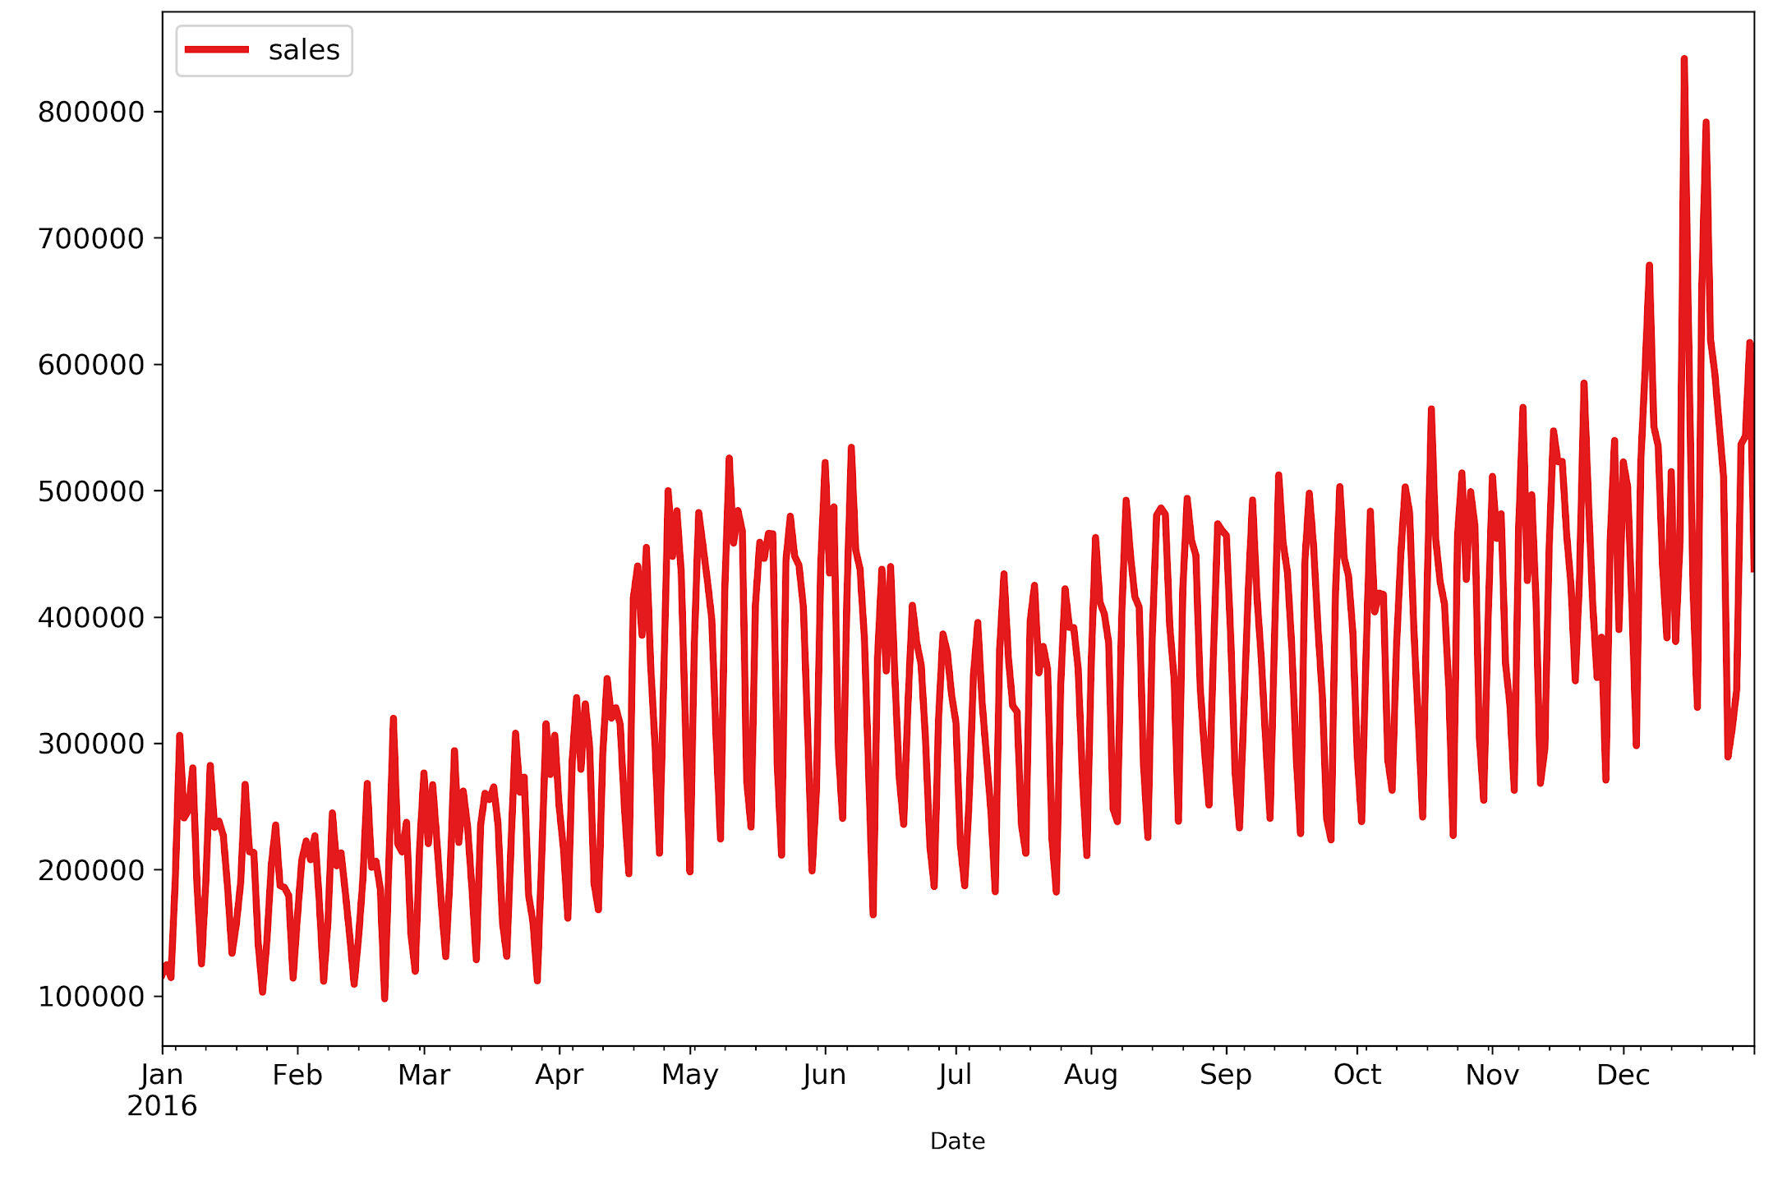
Drug Sales
Exploratory
Data Analysis
Notes:
Now let us move on to our exploratory data analysis. For the time series plot of drug sales, we can see an increasing trend, with huge spikes in the month of December.

Slide 11
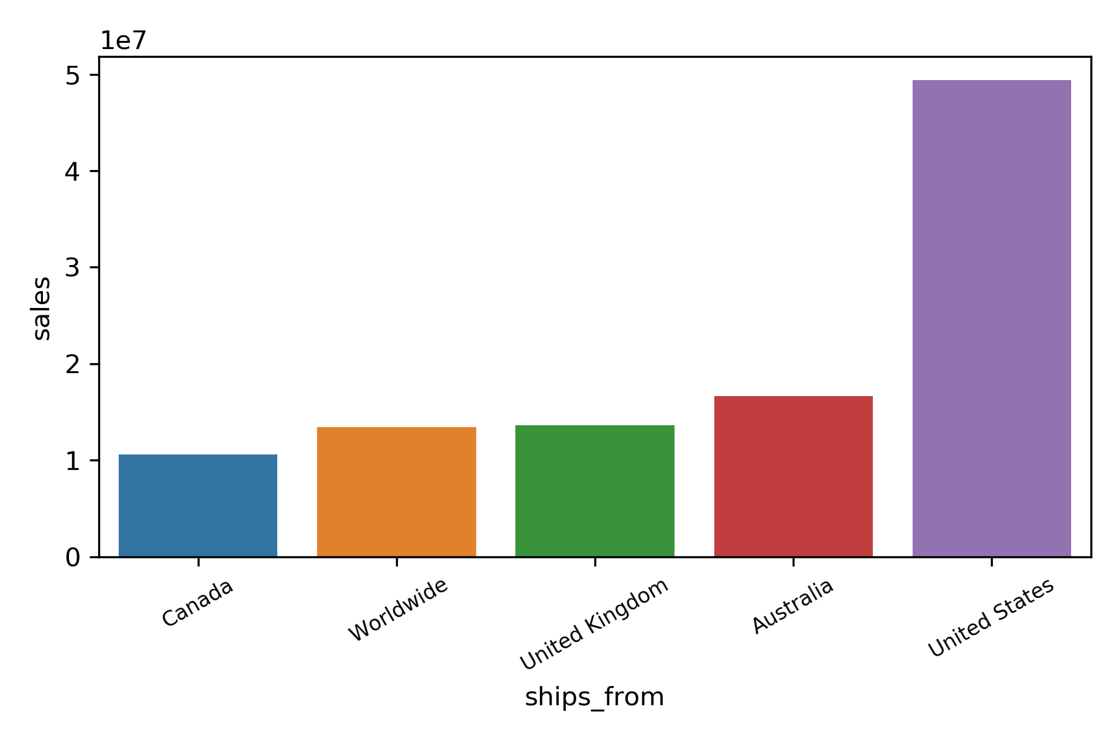
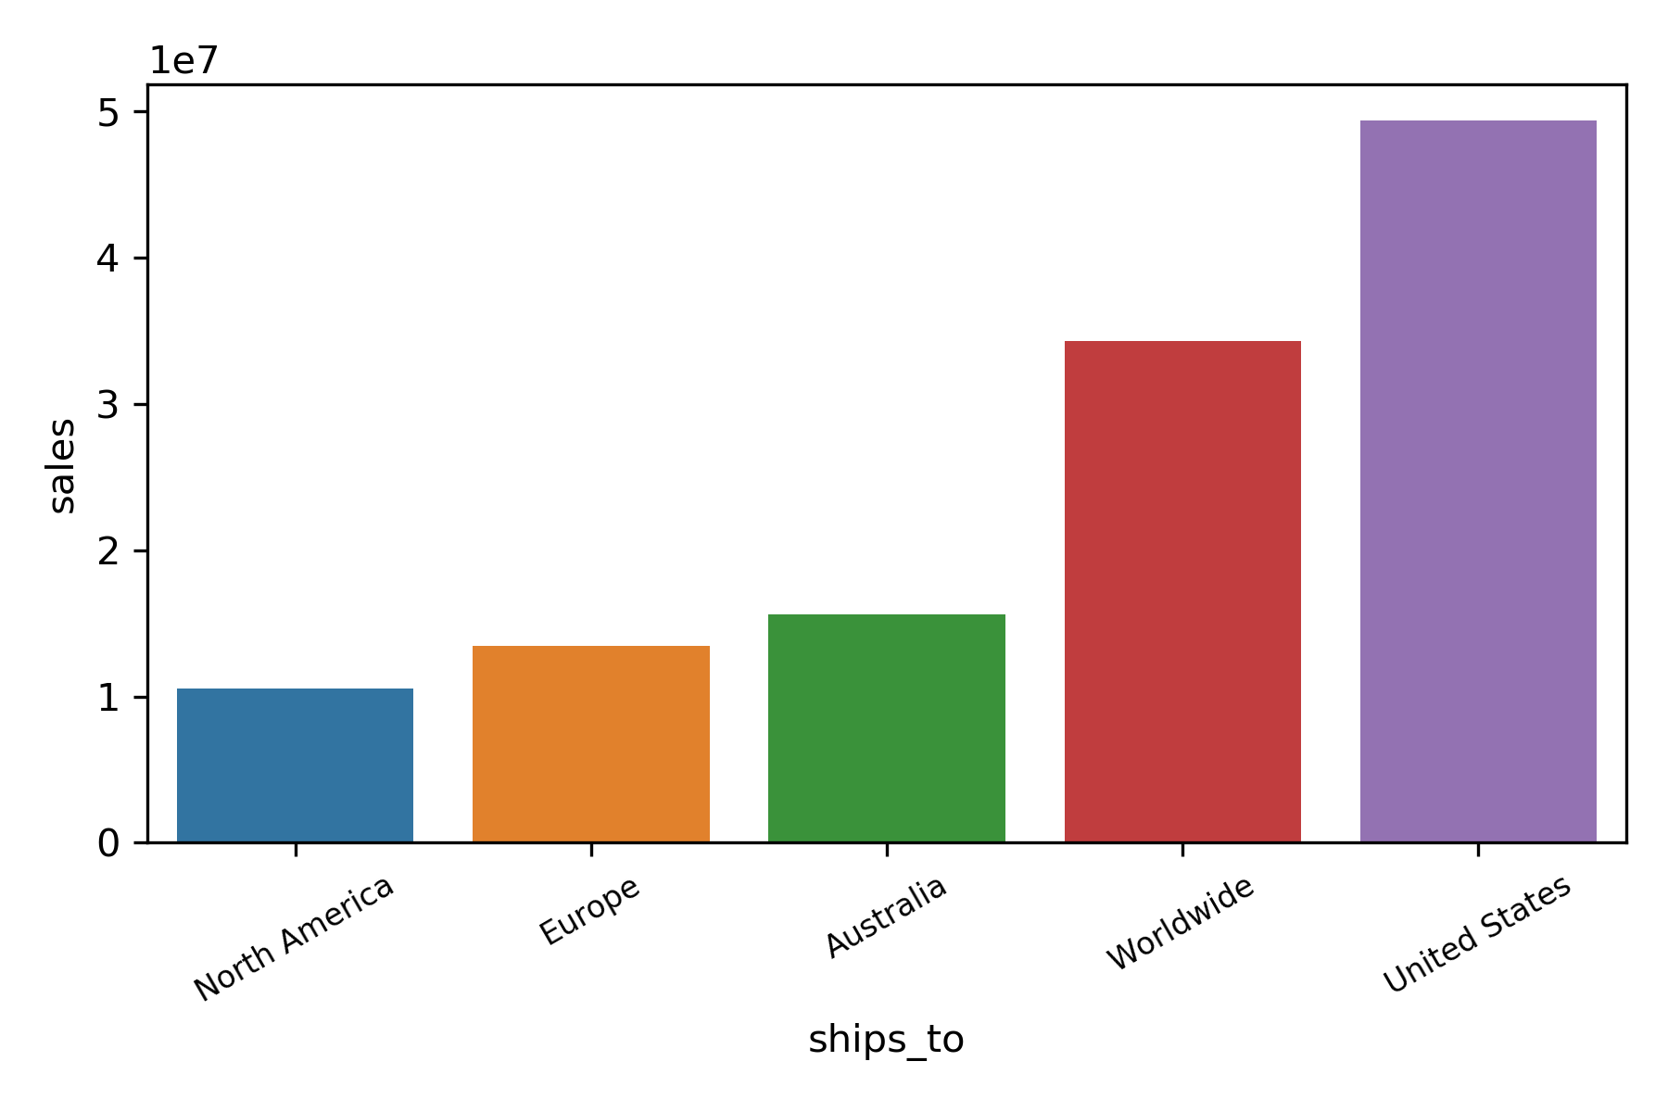
Drug Sales
Notes:
Further analysing Drug_Sales, we can determine the top countries that ship drugs and receive drugs .We can also see that drug sales are overwhelmingly shipped from and to the United States, consistent with our market share analysis earlier.

Slide 12
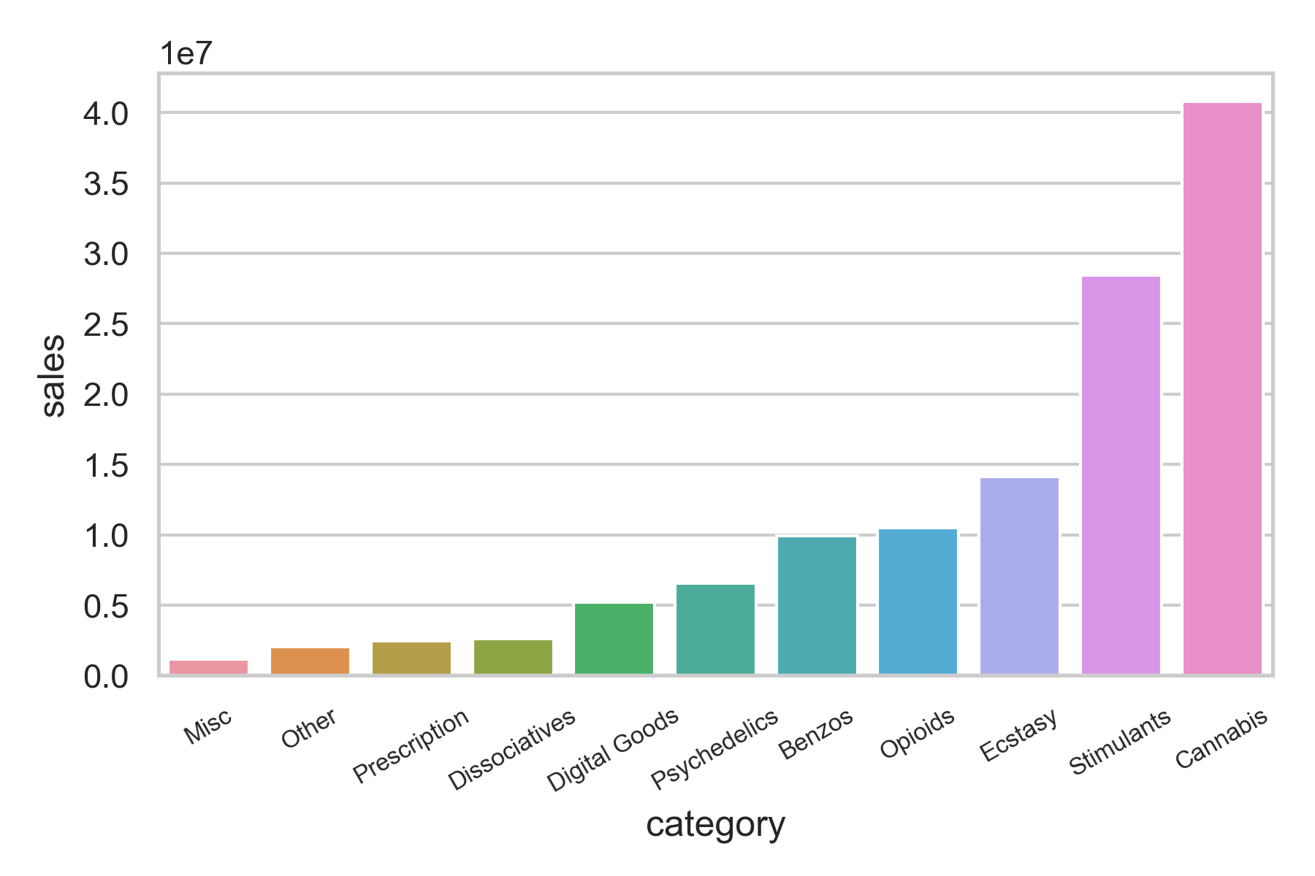
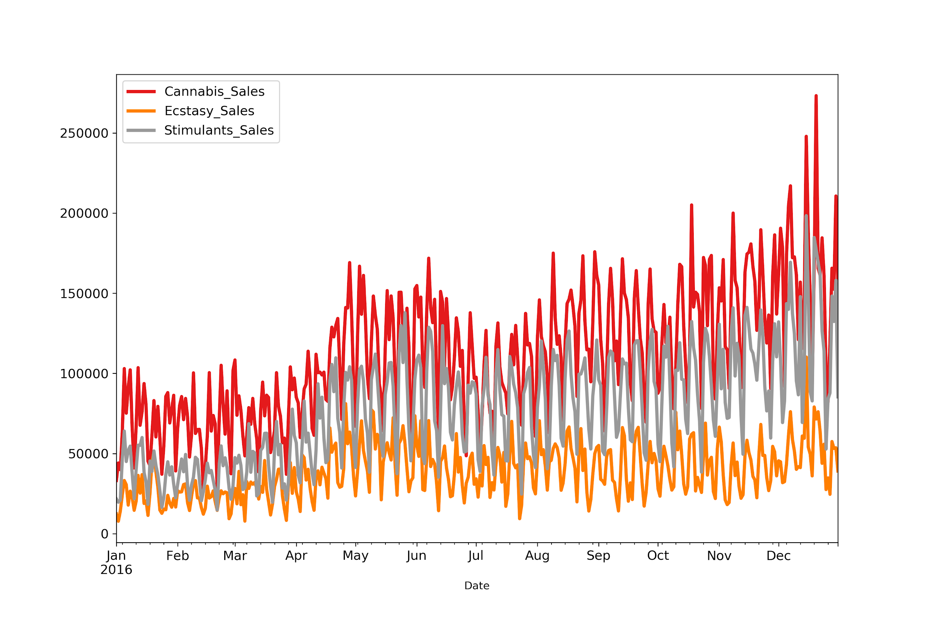
Drug Sales
Notes:
By category, We can see that an overwhelming amount of products are drugs, with the exception of digital goods and dissociatives. The top 3 drugs sold are Cannabis, Stimulants and Ecstasy. We will be analysing these drug categories in depth later. For the time series plot of these 3 categories of drug sales, they have a similar pattern to total drug sales - an increasing trend and a spike in December.

Slide 13
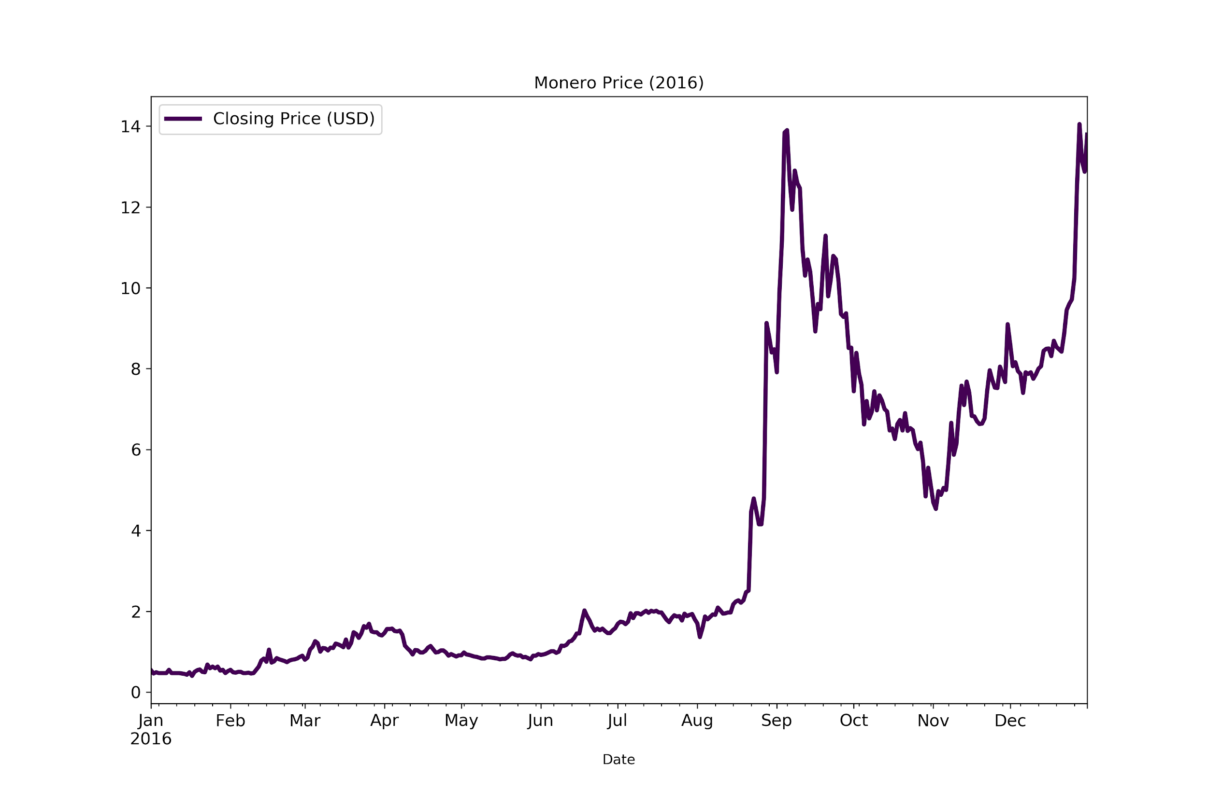
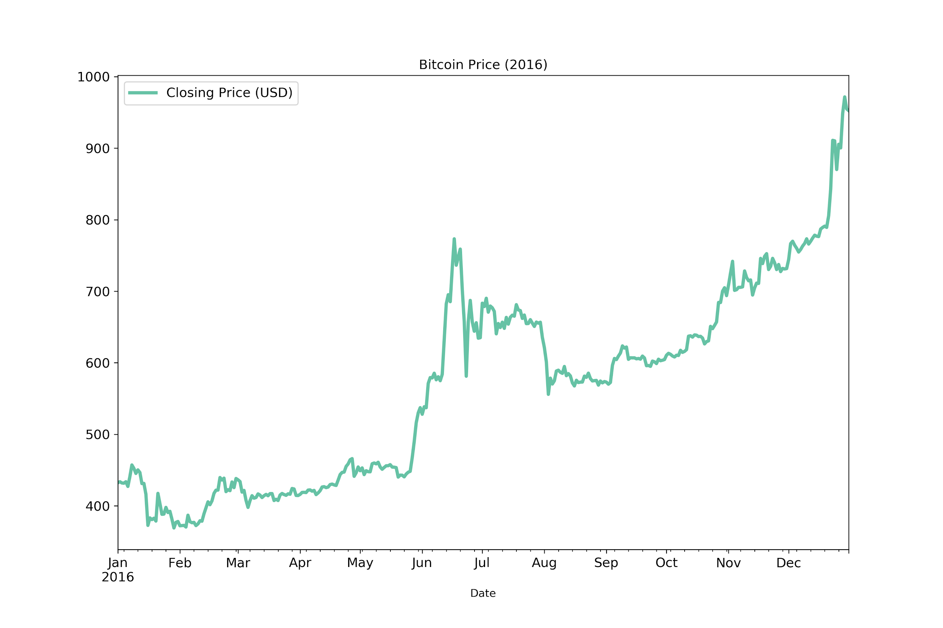
Monero
Bitcoin
Notes:
Onto the time series plots of the cryptocurrencies, both exhibit an increasing trend. We can see that Monero had a huge spike in September, followed by a gradual decline and immediate spike in November. For Bitcoin, prices rose in June, dropped a bit, then gradually increased again in August.

Slide 14
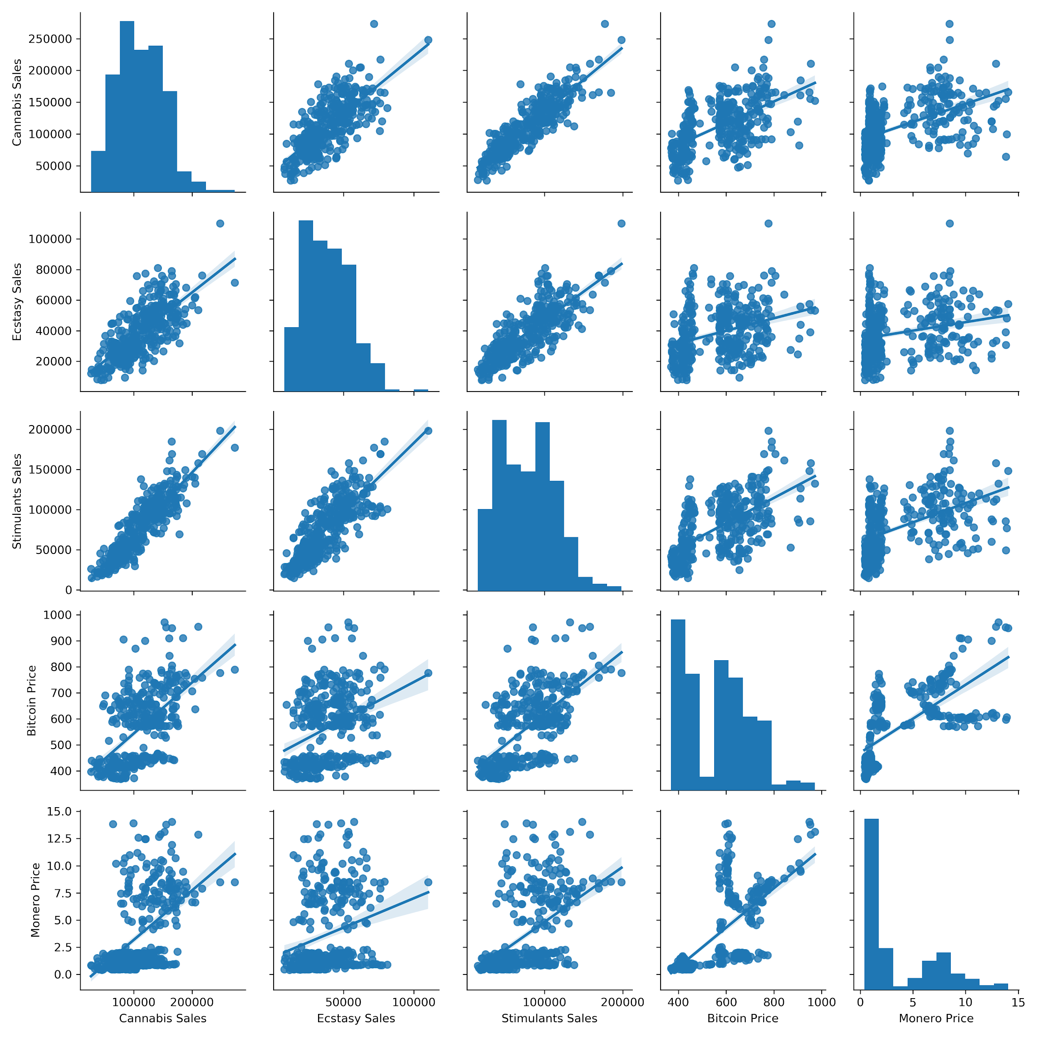
Scatterplot
Matrix
Notes:
Finally, let us look at the scatterplot matrix. This pair plot shows us the pairwise relationships between the variables. For each category of drug sales (Cannabis, Ecstasy and Stimulants) , we can see that there is a weak correlation between them and the prices of Bitcoin and Monero as the regression line for these pairs have a rather lenient slope. That will be it for our introduction and I will now pass the time on to Jeremy to talk about our analyses.

Slide 15
Creating VAR Model in Python
Check for Stationarity
Model Determination
Model Estimation and Diagnostics
Structural Analysis
Total Drugs vs Bitcoin vs Monero (Daily)
Notes:
A Vector Autoregressive model comprises multiple time series. An extension of the auto-regressive (AR) model, it involves multiple independent variables and thus includes multiple equations. All variables in a VAR enter the model in the same way, where each variable has an equation explaining its evolution based on its own lagged values, the lagged values of the other model variables, and an error term. Time series models for VAR are usually based on applying the model to stationary series. We will now create a VAR model using Total Drugs, Bitcoin, Monero (Daily).

Slide 16
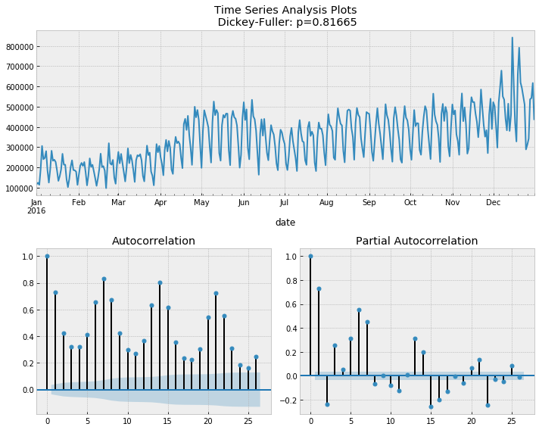
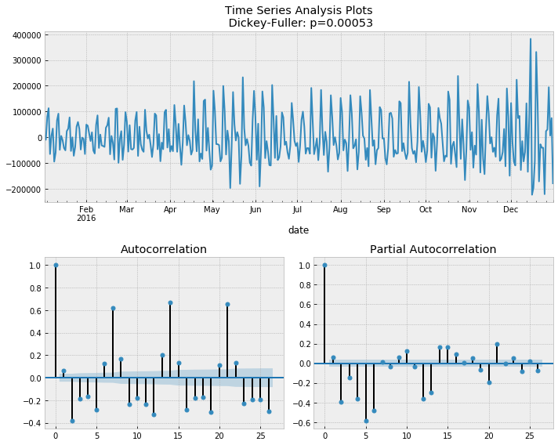
Drug Sales
Notes:
We will now plot the time-series of Bitcoin prices, Monero prices and Drug Sales in 2016. We observe some fairly similar trend patterns in our time series which imply that each of the variables might be a linear function of some past values of itself and the past values of the other variables.
The VAR model requires the time series to be stationary, hence we use the ADF test to check for stationarity. By conducting the ADF test on all datasets and plotting out the time series, we find they are not stationary as all of them have a p-value of more than 0.05.
Results show that all have a p-value of > 0.05. We fail to reject the Null Hypothesis, indicating that the series are non-stationary and contain a unit root. Thus, we difference the data to remove systematic structure from the time series and re-run the ADF test, getting the following results.
Since the differenced variables are stationary, we can now proceed to our VAR modelling. We obtain the following information criteria for lag orders up to VAR(10).

Slide 17
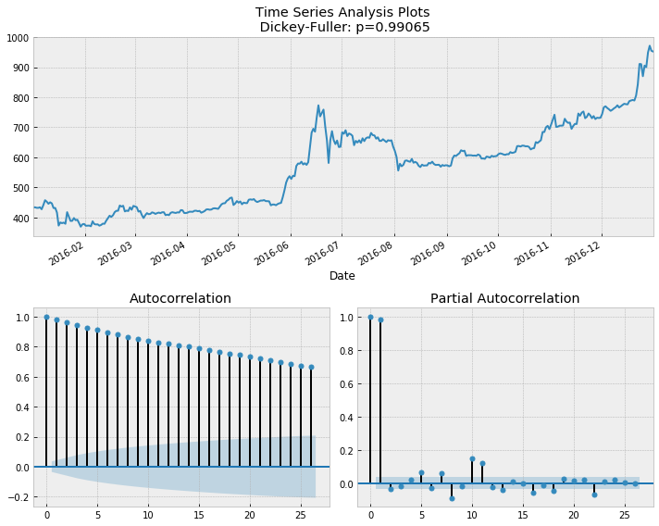
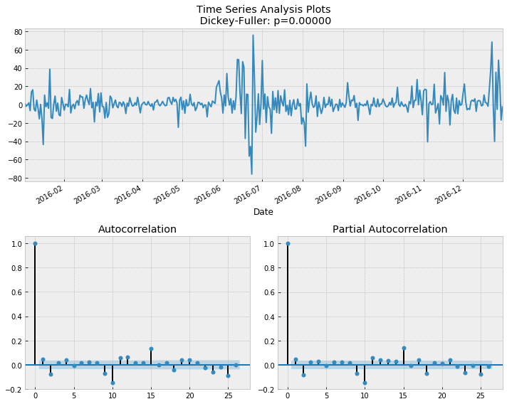
Bitcoin Price

Slide 18
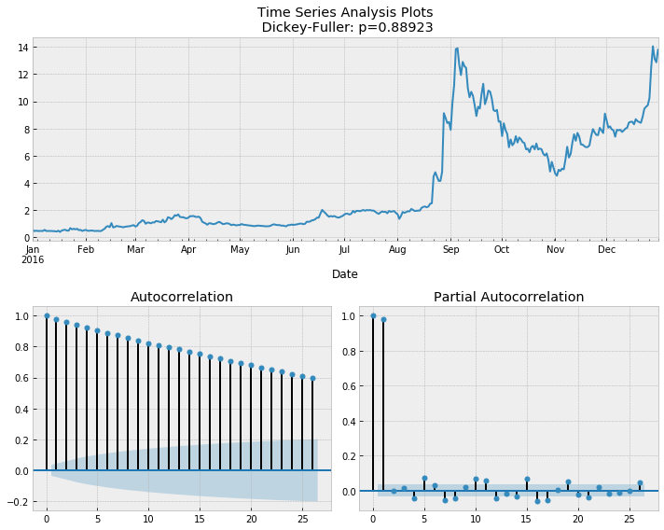
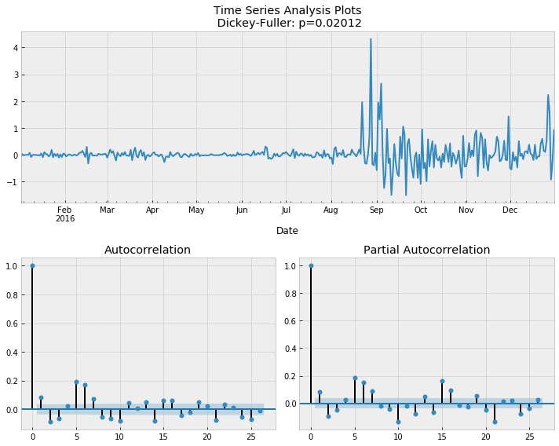
Monero Price

Slide 19
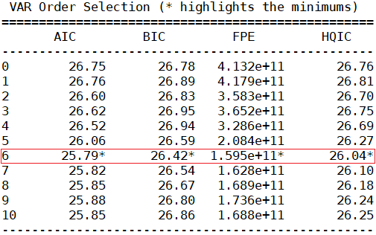
Model Order Selection
Notes:
To select the right order of the VAR model, we iteratively fit increasing orders of the VAR model and pick the order that gives a model with least AIC, BIC, FPE or HQIC values. Should there be a tie, we will use AIC since it gives us less errors in forecasting. In this particular case, values of all parameters show us that lag 6 gives us the best model. Hence, we concluded that the lag order 6 is the most appropriate for this model

Slide 20
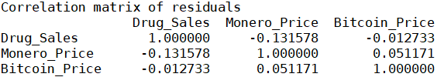
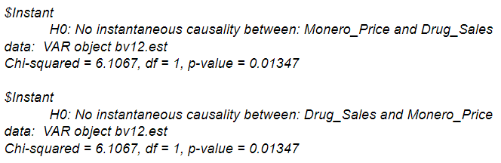
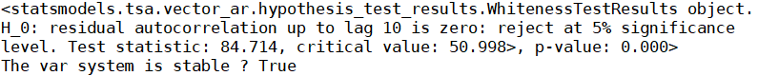
Correlation Matrix
Contemporaneous Relations
Whiteness Test
Notes:
Explain creation of model
We observe a relatively weak correlation among the 3 variables. Since the off-diagonal elements of the estimated correlation matrix are not zero, we therefore decide to investigate further by testing for instantaneous causality between the variables pairwise in the relevant section.
We also conduct a Residual whiteness test using Portmanteau test where H₀: The residual autocorrelation up to lag 10 is zero.
With p-value < 0.05, we reject the null hypothesis, indicating that at least one series is not white noise. We also examine the eigenvalues of the VAR(6) and observe the roots to be lying outside the unit circle, therefore satisfying the stability condition.
We observe many statistically insignificant independent variables, where at 5% significance level, Drug _Sales is influenced by past values of Drug_Sales, Monero_Price is influenced by past values of Monero_Price, Bitcoin_Price and Drug_Sales while Bitcoin_Price is influenced by past values of Monero_Price.

Slide 21
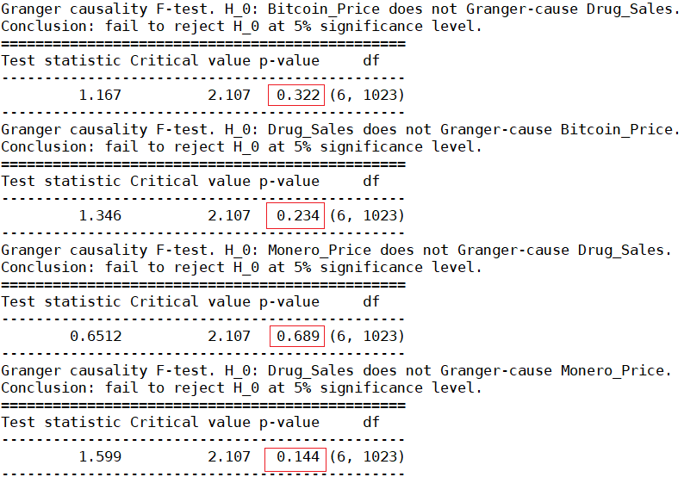
Granger Causality
Notes:
Conduct structural analysis
We observe that the null hypothesis, H₀: There is no granger causality, is not rejected between all the variables. There is no granger causation.

Slide 22
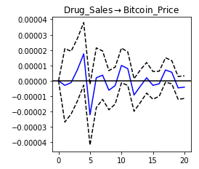
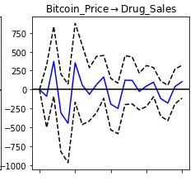
Impulse Response Analysis
Notes:
Our granger causality may not give us the complete story of the interactions between the variables in our system. Therefore, we plot the Impulse Response Functions (IRF) to observe the response of one variable to one unit shock of another, as well as study the multiplier effects.
So in this irf plot we see that
Bitcoin_Price has insignificant negative response to shocks from Drug_Sales which increase to positive quickly and stabilizes at 0
Drug_Sales have a moderate negative response to shocks from Bitcoin_Price before sharply decreasing to a significant negative response.
Before that
Given that there are contemporaneous relations between Drug_Sales and Monero_Price, we need to observe the orthogonalized IRF between these two variables as the orthogonal IRF measures the isolated effect from a shock in one variable to another. See in the next slide:

Slide 23
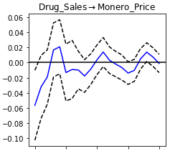
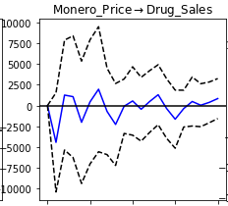
Impulse Response Analysis
Notes:
In the orthogonalised plot:
Monero_Price has a moderate negative response to shocks from Drug_Sales which quickly increase to positive, and stabilize at 0.
Drug_Sales has significant negative responses to shocks from Monero_Price which quickly increase to positive.
It may be myopic to only observe IRF in the short term. To evaluate the long run effect, we also plot and observe the cumulative impulse response.

Slide 24
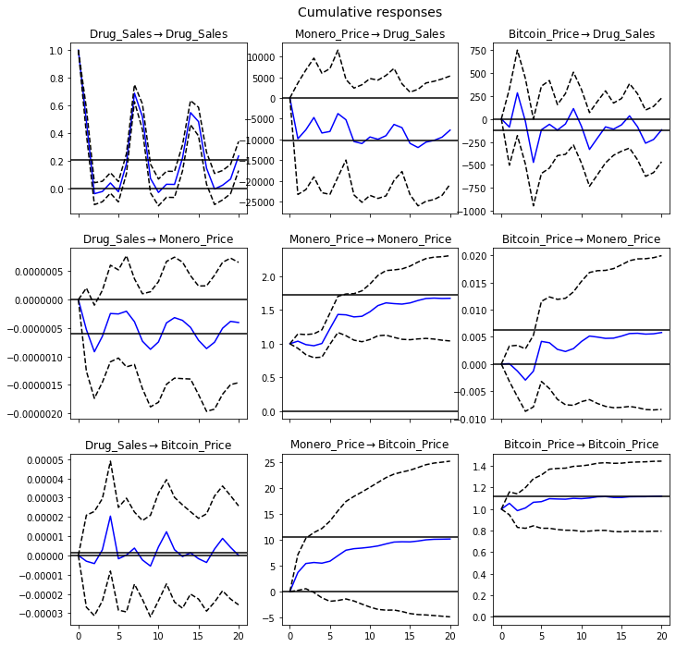
Impulse Response Analysis
Notes:
Similar to the short term IRFs, the long term IRF shows that variables respond positively to shocks from itself. However in the long term, instead of stabilizing at 0, all 3 variables reach some sustained positive response to shocks from itself.
Bitcoin_Price has insignificant negative response to shocks from Drug_Sales which increase to positive quickly and stabilizes at 0
Drug_Sales have a moderate negative response to shocks from Bitcoin_Price before sharply increasing to a significant positive response which decreases to some sustained negative response.

Slide 25
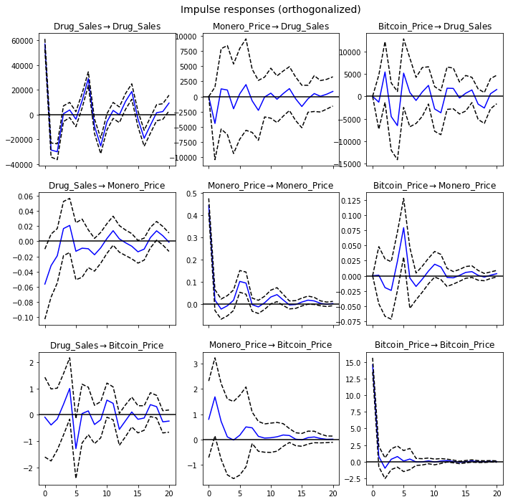
Impulse Response Analysis
Notes:
Monero_Price has a moderate negative response to shocks from Drug_Sales which quickly increase to positive, and stabilize at 0.
Drug_Sales has significant negative responses to shocks from Monero_Price which quickly increase to positive.

Slide 26
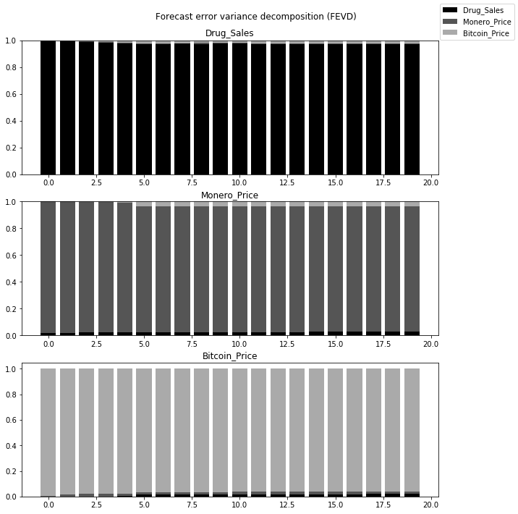
Forecast Error Variance Decomposition
Notes:
The forecast error variance decomposition (FEVD) measures the fraction of the forecast error variance of a variable that can be attributed to another variable.
In this FEVD, we observe that:
Prediction of Drug_sales is largely determined by Drug_sales shocks and minimally affected by Bitcoin_Price
Prediction of Monero_price is largely determined by Monero_price shocks, with some small influence from Drug_sales and Bitcoin_Price
Prediction of Bitcoin_Priceis largely largely determined by Bitcoin_Price shocks, with some small influence from Drug_sales and Monero_Price
The variance in the forecast error of all the variables is mainly explained by the variable alone, i.e, the orthogonal shocks to other variables in the system do not increase the variance of your forecast error. These findings are relatively consistent with both our observations from our short term/long-term impulse response functions and granger causality tests.

Slide 27
Vector Error Cointegration Model
Model Determination
Cointegration Test
Model Estimation and Diagnostics
Total Drugs vs Bitcoin vs Monero (Daily)
Notes:
While VAR models are useful for multivariate series analysis, differencing the series to make them stationary comes at a cost of ignoring “long run” relationships between levels. Hence, an alternative would be to implement a Vector Error Cointegration Model (VECM), which combines levels and differences. Before we implement this model, we need to test whether the level regressions are cointegrated using Johansen’s Test.

Slide 28
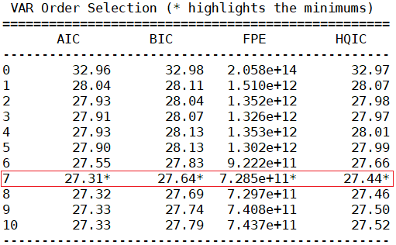
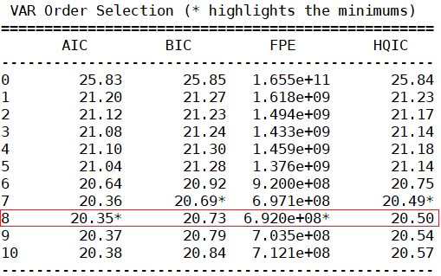
Drug_Sales and Bitcoin_Price
Drug_Sales and Monero_Price
Notes:
In order to conduct Johansen’s Cointegration Test, we must first determine the number of lags. We get the number of lags based on the information criteria on our VAR model.

Slide 29
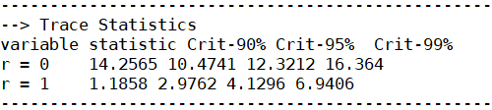
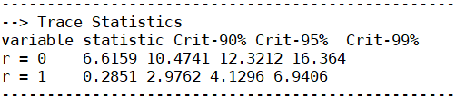
Drug_Sales and Bitcoin_Price
Drug_Sales and Monero_Price
Notes:
We first conduct Johansen’s test with the number of lagged differences set as 7 for Drug_Sales and Bitcoin_Price, with No deterministic terms
The trace statistics tell us whether the sum of the eigenvalues is 0. The null hypothesis, r=0 gives us a trace statistic of 14.2565, hence the null hypothesis can be rejected at a 95% confidence level, as the magnitude of the trace statistic is greater than the critical value. We can conclude that there is at least one cointegrating vector in the system. Therefore, we can model a VECM for Drug_Sales and Bitcoin_Price.
In the second case, the null hypothesis, r=0 gives us a trace statistic of 6.6159 which is less than 12.3212, the critical value at 95%. Hence the null hypothesis cannot be rejected at a 95% confidence level. We can conclude that there is no cointegrating vector in the system. Therefore, we cannot model a VECM for Drug_Sales and Monero_Price.

Slide 30
Whiteness Test
Notes:
creating a VECM model for Drug_Sales and Bitcoin_Price...
With p-value < 0.05, we reject the null hypothesis, indicating that at least one series is not white noise. We also examine the eigenvalues of the VECM model and observe the roots to be lying outside the unit circle, therefore satisfying the stability condition.

Slide 31
Forecasting
Notes:
Having understood the methodology to determine a VAR and VECM model, we shall now use them to forecast Bitcoin Price (Daily) using Drug Sales. We first fit the respective models onto the relevant datasets, where we split it into training and testing data using a 70-30 ratio. The training data, which dates from 1 January 2016 to 12 September 2016, will be used to forecast values that will be compared against the actual values present in the testing data, which dates from 13 September 2016 to 31 December 2016. Then, we will evaluate the models’ accuracy.

Slide 32
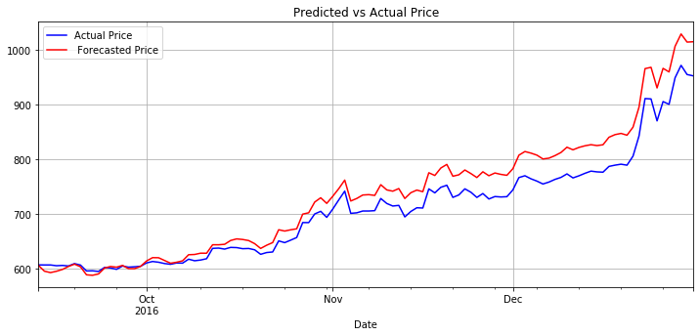
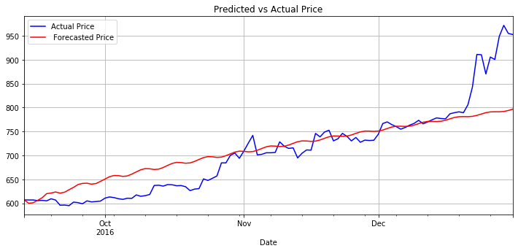
VAR vs VECM
Bitcoin Prices
Notes:
For forecasting using a VAR model, it is important to note that we have used differenced values. Hence, we need to de-difference the data in order to return to its original scale. We have rectified this problem by taking the cumulative sum of our differenced data to produce the following forecast:

Slide 33
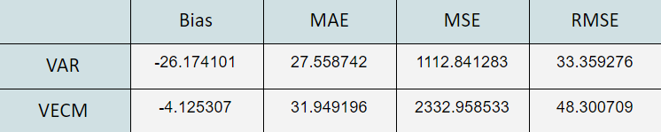
Accuracy
A
Notes:
We can see that our VAR forecast is more accurate based on RMSE. While the bias is more negative as it consistently forecasts prices lower than actual, it is able to forecast the trend of actual prices more accurately. For our VECM forecast, the model fails to predict the sharp increase in prices at the end of December. Hence, VAR is the better model for predicting daily Bitcoin Prices using Total Drug sales.

Slide 34
Exploring Further Relationships
Determine Forecast Variables
Choosing best Forecasting models
Evaluation
Notes:
We have successfully concluded that Drug Sales can be used to predict daily Bitcoin Price using a VAR model. However, this may not be the best model. Many other variables can be used to predict Bitcoin and Monero prices, be it daily, weekly or biweekly, and may even be more accurate. To find the most ideal variables, we have decided to use Granger Causality to identify those variables.
As Granger Causality is a statistical hypothesis test that is more easily quantifiable compared to Impulse Response Analysis and FEVD, we will use granger causality p-values to determine which variables are more suitable to be used to forecast our cryptocurrency prices.
In particular, we repeat this process with multiple permutations categorised by drug type (total drugs, cannabis, stimulants or ecstasy), and aggregated over daily, weekly or biweekly time periods. The results of Granger-Causality p-values are summarised by using the in the following matrix, with our full process moved down to the appendix in section 7.

Slide 35
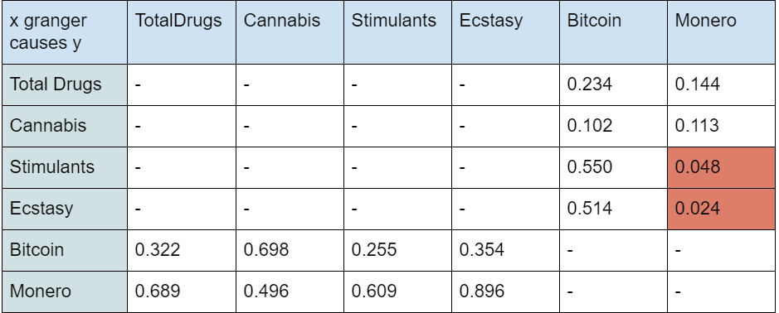
Daily Granger Causality Matrix
Notes:
We can see that there are five p-values less than 0.05. Hence we can conclude that:
For the Daily time period:
Stimulant sales granger causes Monero Price
Ecstasy sales granger causes Monero Price.

Slide 36
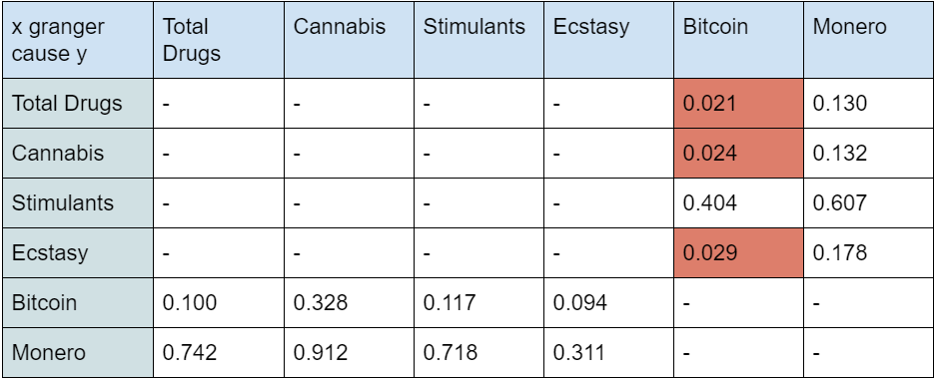
Weekly Granger Causality Matrix

Slide 37
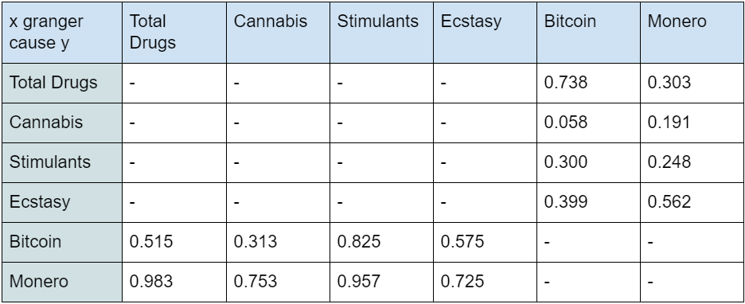
Biweekly Granger Causality Matrix

Slide 38
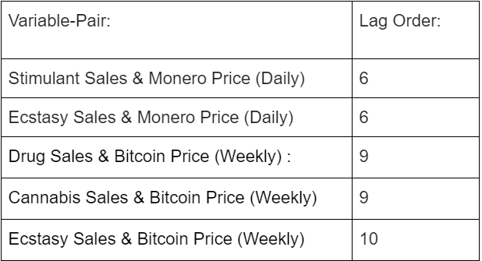
Model Determination

Slide 39
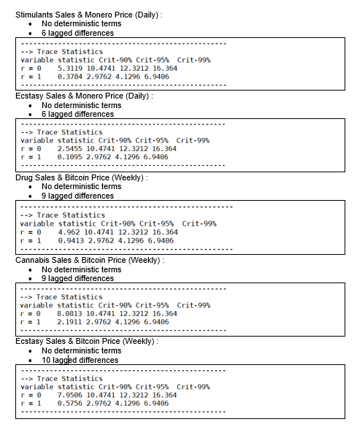
Johansen’s Cointegration Test

Slide 40
Choosing best Forecasting models

Slide 41
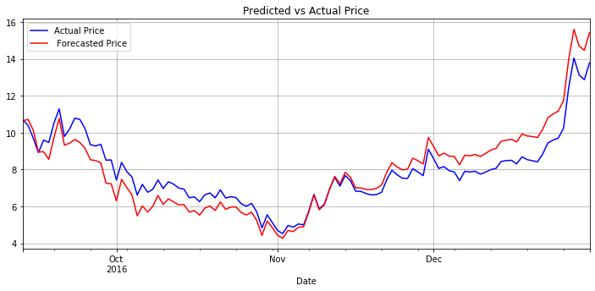
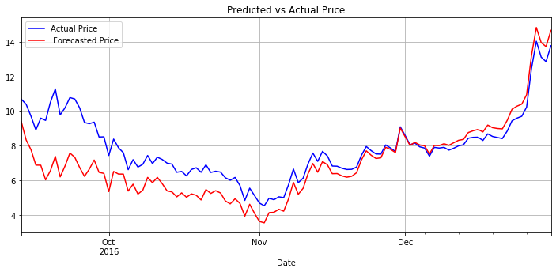
Stimulants sales & Monero price (Daily)
Ecstasy sales & Monero price (Daily)

Slide 42
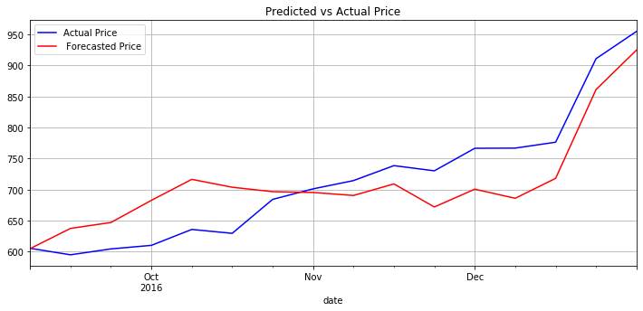
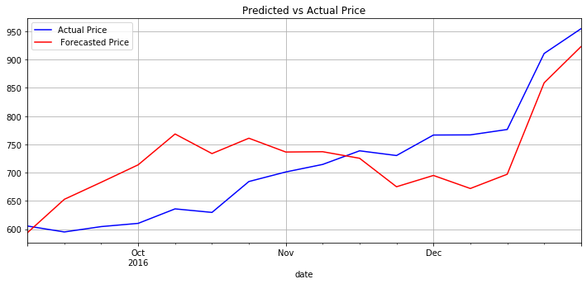
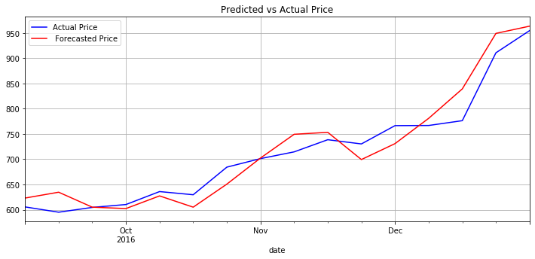
Drug sales & Bitcoin price (Weekly)
Cannabis sales & Monero price (Weekly)
Ecstasy sales & Bitcoin price (Weekly)

Slide 43
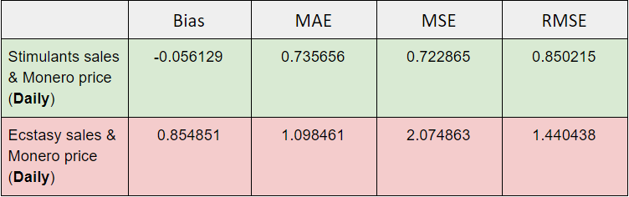

Information Criteria

Slide 44

2017 Stimulants sales & Monero price (Daily)

Slide 45

2017 Ecstasy sales & Monero price (Daily)

Slide 46

2017 Forecast results

Slide 47



Insights

Slide 48
Volatile
Lack of sufficient real time data
Challenging environment
Poor resilience to market variations
Limitations
"Forecasting is a difficult business, particularly when it is about the future" - Yogi Berra

Slide 49
Conclusion
“essentially, all models are wrong, but some are useful”. - George E.P. Box

Slide 50
THANK YOU!

